Slide 1
Virus spreading model pető tamás

Slide 2
Actuality of virus spreading models
In November of 2019 a new virus appeared in Vuhan, China called SARS-CoV-2 (Severe Acute Respiratory Syndrome Corona Virus 2).
The virus cause a disease called COVID-19 (Corona Virus Disease 2019 ).
The new pathogen spreading around the world and until spring of 2020 it is growth to a pandemic
The COVID-19 in a case of 10%-20% cause a serious symptoms which could lead to death
Many scientists around the world work on the cure, others are tried to predicted the future development of the pandemic and the local epidemics.

Slide 3
The applied Model
The model is based on the very simple recursive algorithm.
The used variables and parameters are the following:
Variables: Population, infected, ill, hospitalization decease, recovered, immune,
Parameters:
reproduction index (R₀): the number of infection caused by one infected people
reproduction cycle(R_{C}): the length of time during a group of infected people infect another group of people
disease rate (I): the rate of patient among those are infected
hospitalization rate(H): rate of patients whose need hospitality care among those has symptoms

Slide 4
The applied Model
mortality rate (M): rate death among those patients whose has symptoms
vac: vaccinated people per day
latency time (incubation period): time to first symptoms after the infection (T_{L})
time to hospitalization: time to hospital after the first symptoms (T_{H})
time to decease: time to death after the first symptoms (T_{D})
time recover: : time to recover after the first symptoms (T_{R})

Slide 5
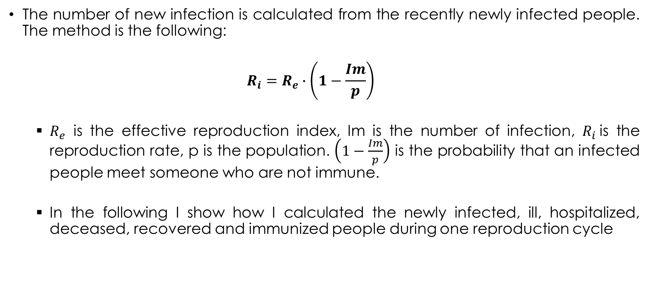
The applied Model
The number of new infection is calculated from the recently newly infected people. The method is the following:
$${R_{i}=R}_{e}∙\left(1−\frac{Im}{p}\right)$$
$R_{e}$ is the effective reproduction index, Im is the number of infection, $R_{i}$is the reproduction rate, p is the population. $\left(1−\frac{Im}{p}\right)$ is the probability that an infected people meet someone who are not immune.
In the following I show how I calculated the newly infected, ill, hospitalized, deceased, recovered and immunized people during one reproduction cycle

Slide 6
The applied Model
In the following I’m showing:
How I calculated the newly infected, ill, hospitalized, deceased, recovered and immunized people during one reproduction cycle. Ito calculate the daily numbers we should divide these numbers with rc.
How I calculated the actually infected, ill and hospitalized. Calculate the actually immune people is further goal.
How I calculated the total number infected, ill, hospitalized, deceased, recovered and immunized people.

Slide 7
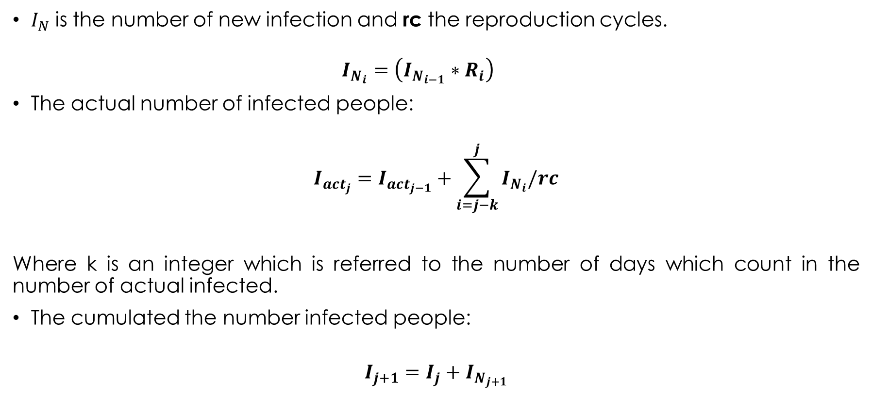
The applied Model
$I_{N}$ is the number of new infection and rc the reproduction cycles.
$$I_{N_{i}}=\left(I_{N_{i−1}}∗R_{i}\right)$$
The actual number of infected people:
$$I_{{act}_{j}}=I_{{act}_{j−1}}+\sum_{i=j−k}^{j}{I_{N_{i}}/rc}$$
Where k is an integer which is referred to the number of days which count in the number of actual infected.
The cumulated the number infected people:
$$I_{j+1}=I_{j}+I_{N_{j+1}}$$

Slide 8
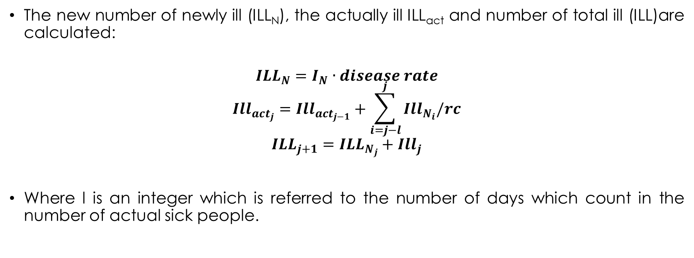
The applied Model
The new number of newly ill (ILL_{N}), the actually ill ILL_{act} and number of total ill (ILL)are calculated:
$${ILL}_{N}=I_{N}∙disease rate$$
$${Ill}_{{act}_{j}}={Ill}_{{act}_{j−1}}+\sum_{i=j−l}^{j}{{Ill}_{N_{i}}/rc}$$
$${ILL}_{j+1}={ILL}_{N_{j}}+{Ill}_{j}$$
Where l is an integer which is referred to the number of days which count in the number of actual sick people.

Slide 9
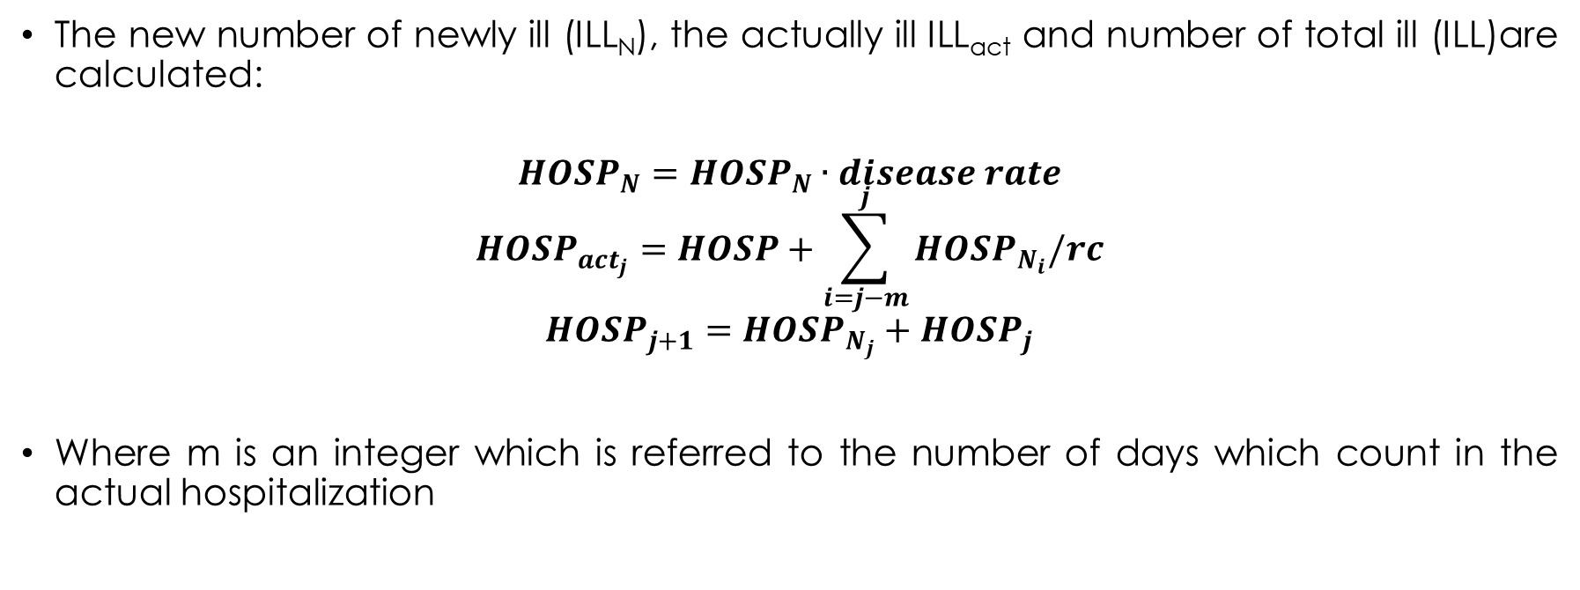
The applied Model
The new number of newly ill (ILL_{N}), the actually ill ILL_{act} and number of total ill (ILL)are calculated:
$${HOSP}_{N}={HOSP}_{N}∙disease rate$$
$${HOSP}_{{act}_{j}}=HOSP+\sum_{i=j−m}^{j}{{HOSP}_{N_{i}}/rc}$$
$${HOSP}_{j+1}={HOSP}_{N_{j}}+{HOSP}_{j}$$
Where m is an integer which is referred to the number of days which count in the actual hospitalization

Slide 10
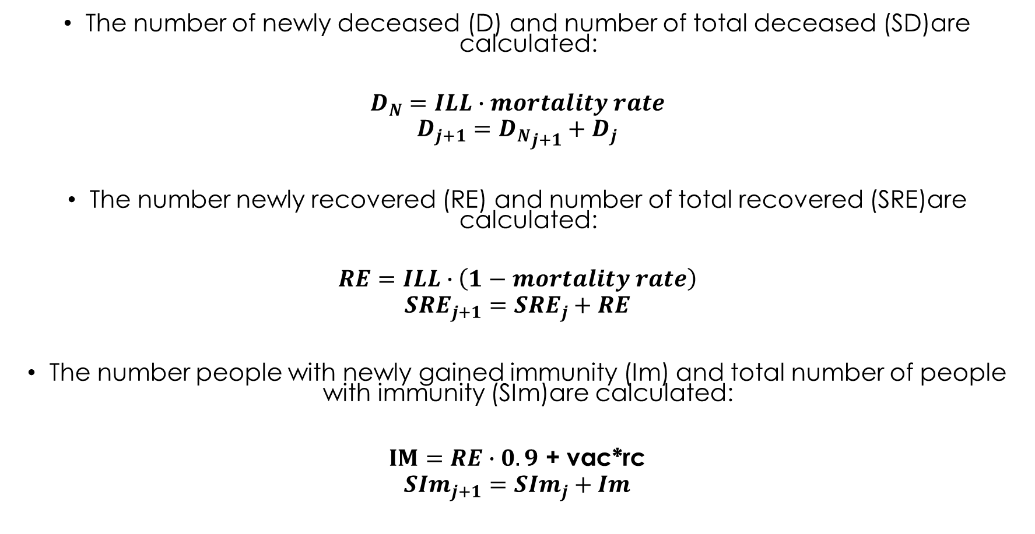
The number of newly deceased (D) and number of total deceased (SD)are calculated:
$$D_{N}=ILL∙mortality rate$$
$$D_{j+1}={D_{N}}_{j+1}+D_{j}$$
The number newly recovered (RE) and number of total recovered (SRE)are calculated:
$$RE=ILL∙\left(1−mortality rate\right)$$
$${SRE}_{j+1}={SRE}_{j}+RE$$
The number people with newly gained immunity (Im) and total number of people with immunity (SIm)are calculated:
$IM=RE∙0.9$ + vac*rc
$${SIm}_{j+1}={SIm}_{j}+Im$$

Slide 11
Test Results - I
I found the best test data types are Hungarian daily mortality and number of hospitalized patient in the 2021.02.21-05.31 period. It were the two parameter set which’s provided results are follow the test data. The first set of parameters was:
T_{L} = 5 day
T_{H} = 4 day
T_{D} = 14 day
T_{R} = 28 day
m = 6
R_{e} = 1.4 - in this case i did not apply the classic value basic it was unpredictable regarding restrictive measures
RC = 5 day
I = 60%
H = 12%
M= 1,5%

Slide 12
Test Results - I

Slide 13
Test Results - I

Slide 14
Test Results - II
The second set of parameters:
T_{L} = 5 day
T_{H} = 7 day
T_{D} = 14 day
T_{R} = 28 day
m = 10
R_{e} = 1.5 – in this case i did not apply the classic value basic it was unpredictable regarding restrictive measures
RC = 6 day
I = 60%
H = 5%
M= 1,1%

Slide 15
Test Results - II

Slide 16
Test Results - II

